Slide 1

FALL 2023
MIS 381N
Information management
Lecture 15
Sept 18th 2023
Prashant D. Joshi
UT McCombs School of Business (MSBA), The University of Texas at Austin

Slide 2

Objectives
OLAP, Enterprise Data Architecture
OLAP
Enterprise data architecture (Discussions based on ‘How to build a data architecture to drive innovation—today and tomorrow’)
Check Canvas
Questions and Discussion

Slide 3
What questions may I answer before we begin …
All questions are good questions

Slide 4
Housekeeping

Slide 5
Housekeeping
Do you read the “Canvas --> Pages --> Pre-reading and discussions for the classes” section before the class. I almost always have some additional material for you to read up before coming to the class. It might help as I often use that material as part of the slides.
Start thinking about projects.
https://olap.com/olap-definition/

Slide 6
OLAP

Slide 7
OLAP (Online Analytical Processing)
OLAP data is multidimensional – organized in dimensions such a Customer, Product, Geography, and Time
OLAP data represents metrics that need to be analyzed as measures at the intersection of the dimensions. For example, sales can be analyzed by Customer, Product, Geography and Time.
Dimensions usually have associated with them hierarchies that specify aggregation levels and hence granularity of viewing data. Some of these hierarchies are Time organized by Year, Quarter, Month, Week and Day or Geography organized by State, County, and City or Product organized by Category, Sub-Category, etc.
Customer
Product
Measures
Sales
Inventory
…
Geography
Time

Slide 8
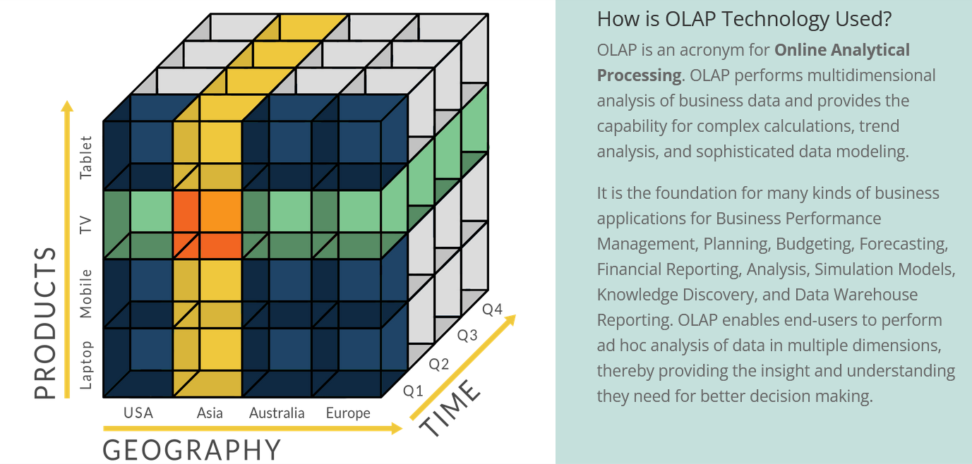
OLAP (Online Analytical Processing)
An OLAP Cube is a data structure that allows fast analysis of data according to the multiple Dimensions that define a business problem. A multidimensional cube for reporting sales might be, for example, composed of 7 Dimensions: Salesperson, Sales Amount, Region, Product, Region, Month, Year.
https://olap.com/olap-definition/

Slide 9
OLAP (Online Analytical Processing)
OLAP cube: Extension of spreadsheet like structure, but on more dimensions
Overcomes RDMBS limitation: RDBMS cannot get near instantaneous analysis and display large data, as they are more for creating records for OLTP
Existing tools are slow esp when need to re-orient reports along a ‘slice’
Cubes provide this kind of fast end-user interaction with data
https://olap.com/olap-definition/

Slide 10
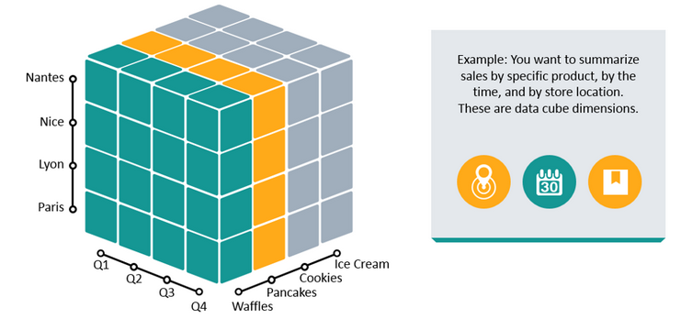
OLAP (so, what’s a ‘Slice’?)
A Slice represents two-dimensional view of an OLAP Cube that arranges data in a grid, similar to a spreadsheet
Slice functions much like a report or a query in an RDBMS in that it returns data based on a request for what to see.
https://olap.com/olap-definition/

Slide 11
OLAP Operations
Roll up: Summarize data (Reduce dimensions)
Drill down, Roll down: Go from higher level summary to lower level summary or detailed data (Increase dimensions)
Slice and Dice: Select and project (Slice: Selection on one dimension, reduces dimensions by one. Dice: Selection on two or more dimensions, sub-cube of same dimension)
Pivot: rotate the cube to show a particular face
https://www.javatpoint.com/olap-operations
https://www.lumeer.io/app-demo/?_o=5f28316989e14f77b2f7fa7a&_p=5f3d692719684b68538a0c7b&tp=false&v=9ed1515819dec61f

Slide 12
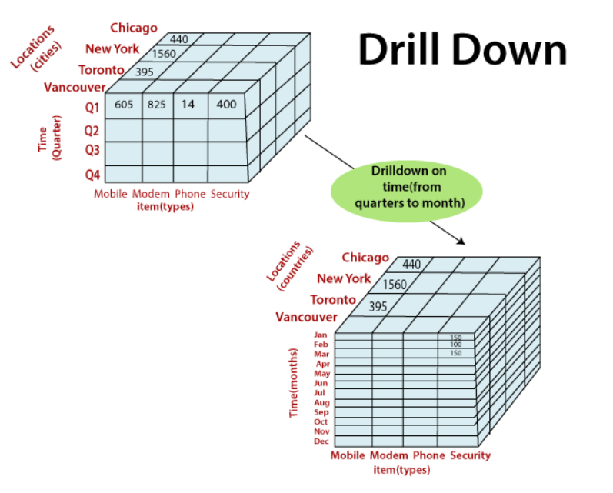
OLAP Operations (In Class discussion)
What is this an example of?
https://www.javatpoint.com/olap-operations
https://www.lumeer.io/app-demo/?_o=5f28316989e14f77b2f7fa7a&_p=5f3d692719684b68538a0c7b&tp=false&v=9ed1515819dec61f

Slide 13
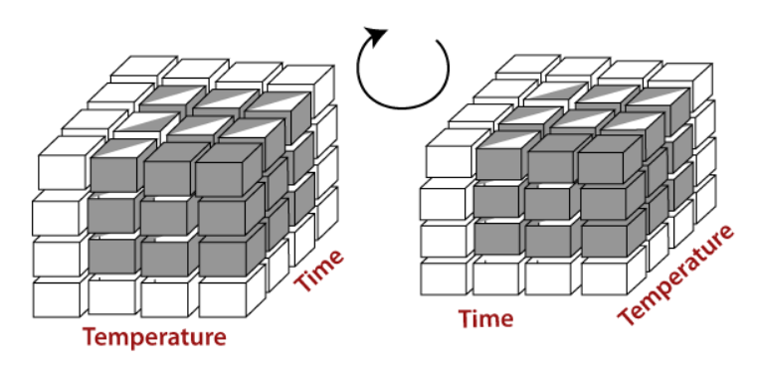
OLAP Operations (In Class discussion)
Pivot
What is this an example of?
https://www.javatpoint.com/olap-operations
https://www.lumeer.io/app-demo/?_o=5f28316989e14f77b2f7fa7a&_p=5f3d692719684b68538a0c7b&tp=false&v=9ed1515819dec61f

Slide 14
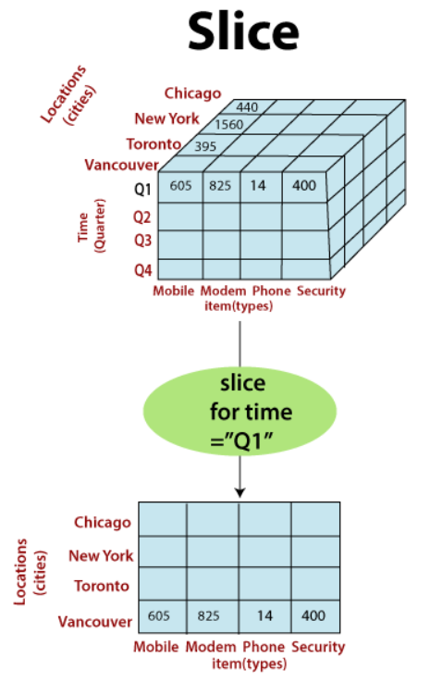
OLAP Operations (In Class discussion)
What is this an example of?
https://www.javatpoint.com/olap-operations
https://www.lumeer.io/app-demo/?_o=5f28316989e14f77b2f7fa7a&_p=5f3d692719684b68538a0c7b&tp=false&v=9ed1515819dec61f

Slide 15
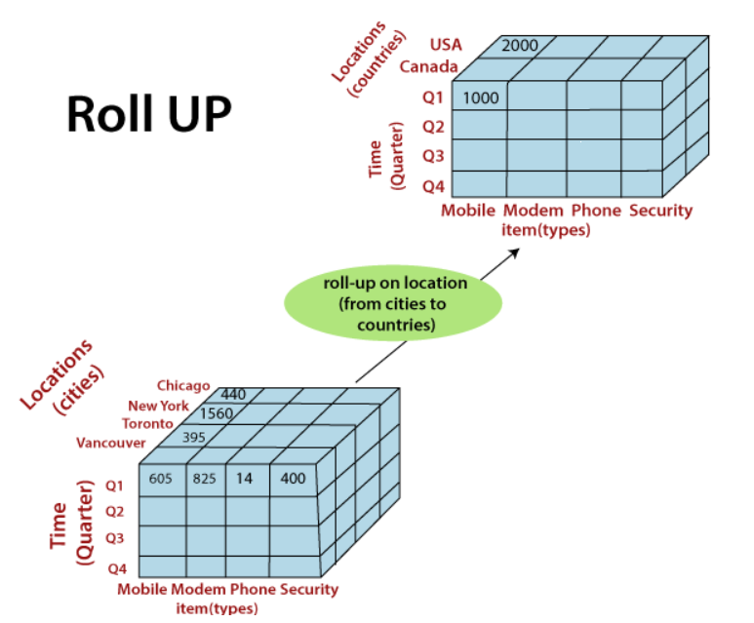
OLAP Operations (In Class discussion)
What is this an example of?
https://www.javatpoint.com/olap-operations
https://www.lumeer.io/app-demo/?_o=5f28316989e14f77b2f7fa7a&_p=5f3d692719684b68538a0c7b&tp=false&v=9ed1515819dec61f

Slide 16
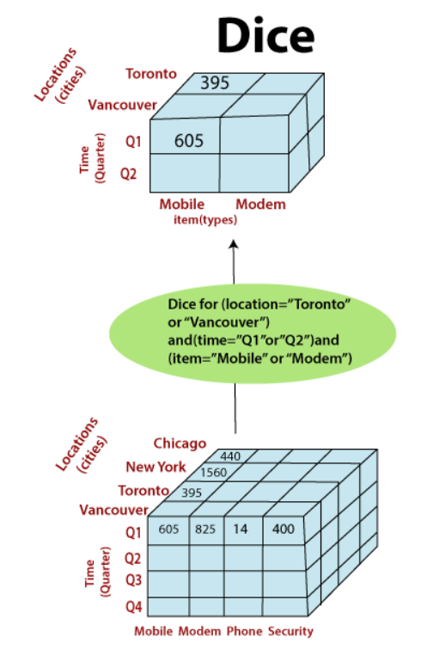
OLAP Operations (In Class discussion)
What is this an example of?
https://www.javatpoint.com/olap-operations
https://www.lumeer.io/app-demo/?_o=5f28316989e14f77b2f7fa7a&_p=5f3d692719684b68538a0c7b&tp=false&v=9ed1515819dec61f

Slide 17
OLAP Operations
There are other OLAP operations as well
A few interesting ones:
Drill-through : make use of relational SQL relational tables
ranking the top-N or bottom-N elements in lists
calculate moving average, growth rates, and interests, internal rates of returns, depreciation, currency conversions, and statistical tasks
https://www.javatpoint.com/olap-operations
https://www.lumeer.io/app-demo/?_o=5f28316989e14f77b2f7fa7a&_p=5f3d692719684b68538a0c7b&tp=false&v=9ed1515819dec61f

Slide 18
OLAP Operations
OLAP offers analytical modeling capabilities, containing a calculation engine for determining ratios, variance, etc. and for computing measures across various dimensions.
It can generate summarization, aggregation, and hierarchies at each granularity level and at every dimensions intersection.
OLAP also provide functional models for forecasting, trend analysis, and statistical analysis.
Thus, the OLAP engine is a powerful data analysis tool.
https://www.javatpoint.com/olap-operations
https://www.lumeer.io/app-demo/?_o=5f28316989e14f77b2f7fa7a&_p=5f3d692719684b68538a0c7b&tp=false&v=9ed1515819dec61f

Slide 19
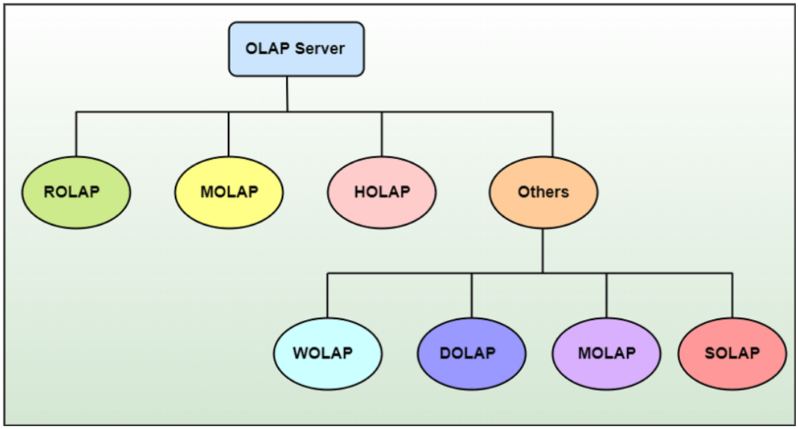
Types of OLAP
Mainly three types, but many others do exist
https://www.javatpoint.com/data-warehouse-types-of-olap

Slide 20
Types of OLAP (Class Participation coming up)
MOLAP – Multi-dimensional OLAP Dimension and aggregate hierarchies are pre-computed and stored Underlying database is optimized for MOLAP operations and deviates from relational database standards
ROLAP – Relational OLAP Dimensions and aggregate hierarchies are specific in metadata and computed on demand Underlying database is relational, and indexes are optimized for ROLAP vs. OLTP – performance, purpose, data flows
ROLAP vs. MOLAP
Performance vs. flexibility
Storage
Implementation complexity

Slide 21
Enterprise Data Architecture

Slide 22
Recap: Components of Data Management
Business Purpose of Data
Dictated by first three components
Centralized and/or distributed?
Structured and/or unstructured?
Relational and/or non-relational
Type of unstructured data: text, images, audio, video, …
Requirements for Reliability, Availability, Serviceability, Usability, Installability (RASUI)
Requirements for security, privacy and retention
Characteristics of Data under Management
Data Management Operating Model
Data Management Technology Architecture

Slide 23
Recap: Typical Data Management Technology Ecosystem
SQL, Applications, Business Intelligence, Dashboards, …
Transactional Data (Relational)
Metadata (Relational)
Data Warehouse (Relational Normalized)
(Massively Parallel Processing—MPP)
Data Marts (Relational)
Business Processes
Reference Data (Relational)
External Data
Data Lake (Non-Relational)
Data Lake (Non-Relational)
Streaming Data (Non-Relational)
Data Lake (Non-Relational)
Data Lake(Non-Relational)
IoT Sensors
On device file storage
SAS, R, Python, MapReduce, Spark, …

Slide 24
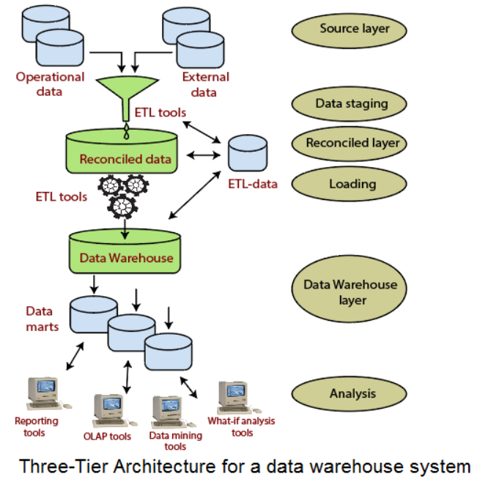
Current Data Architectures …
Recall this?

Slide 25
Current Data Architecture Impedes …
Digitization
Competing with disruptive digital business models
Agile response to changing customer needs
Business value from technology investments
Recruiting dynamic talent with modern skill sets
Enterprise wide innovation

Slide 26
How should companies respond?

Slide 27
Six Technology Shifts (Homework coming up)
From on-premise to cloud-based data systems
1
From point-to-point to decoupled data access
4
From batch to real-time data processing
2
From an enterprise warehouse to domain-based architecture
5
From monolithic commercial solutions to modular, best-of-breed platforms
3
From rigid, fixed data models to flexible, extensible data schemas
6
Source: McKinsey

Slide 28
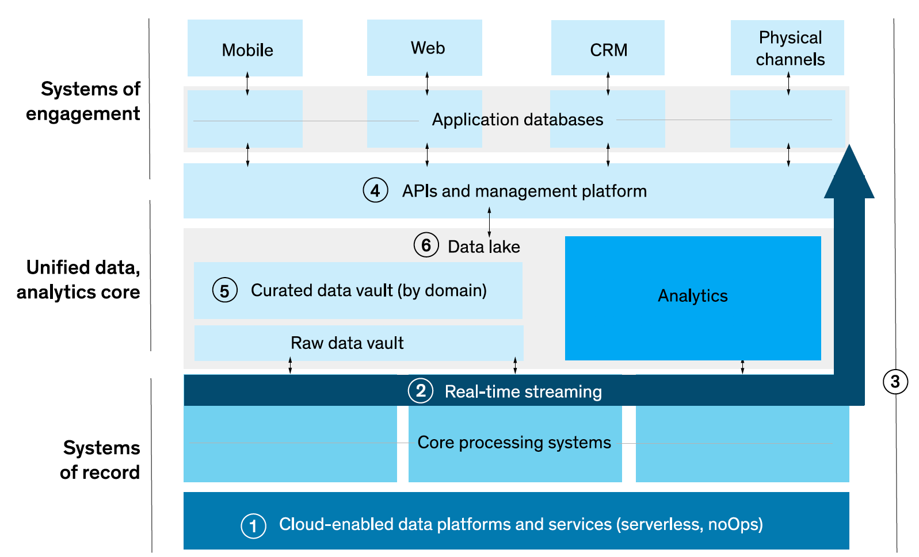
Upgraded Data Architecture
Source: McKinsey

Slide 29
What is different about the upgraded architecture?
Please discuss this in your reflections

Slide 30
What is different about the upgraded architecture?
Analytical data is updated more frequently
Analytical data supports channels of engagement – so have to deal with transaction type workloads
Streaming data bypasses analytical data stores and feeds channels of engagement
”Models” need to be updated, deployed and monitored for performance continuously
Systems of record are gradually modularized
Data pipelines are intelligent and more complex

Slide 31
Six Technology Shifts
From on-premise to cloud-based data systems
1
Serverless data platforms such as Amazon S3 – data centric applications that can scale – can use SQL like interfaces against data in files
Containerized data solutions such as those using Kubernetes – modularize applications, decouple software environment from hardware
Source: McKinsey

Slide 32
Six Technology Shifts
From batch to real-time data processing
2
Messaging platforms such as Kafka – scalable, durable, fault-tolerant publish/subscribe services
Streaming processing and analytics solutions such as from Apache – Kafka Streaming, Flume, Storm, and Spark Streaming – direct analysis of messages in real time
Alerting platforms such as Graphite or Splunk
Source: McKinsey

Slide 33
Six Technology Shifts
From monolithic commercial solutions to modular, best-of-breed platforms
3
Data pipeline and API-based interfaces simplify integration between disparate tools and platforms – data abstraction
Analytics workbenches such as Amazon Sagemaker and Kubeflow simplify building end-to-end solutions in a highly modular architecture (modularized)
Source: McKinsey

Slide 34
Six Technology Shifts
From point-to-point to decoupled data access
4
An API management platform –API gateway –create and publish data-centric APIs including usage policies, control access, and metering for usage and performance
A data platform to “buffer” transactions outside of core systems
Source: McKinsey

Slide 35
Six Technology Shifts
From an enterprise warehouse to domain-based architecture
5
Data infrastructure as a platform – common tools and capabilities for storage and management – data producers can build data-asset platforms
Data virtualization techniques to organize access and integrate distributed data assets.
Data cataloging tools – search and exploration without access
Source: McKinsey

Slide 36
Six Technology Shifts
From rigid, fixed data models to flexible, extensible data schemas
6
Data vault 2.0 techniques, such as data-point modeling result in extensibility
Graph and other NoSQL databases result in flexibility
Query file-based data akin to relational databases (e.g. Azure Synapse Analytics, Amazon S3 Glacier Select)
Using JavaScript Object Notation (JSON) to store information
Source: McKinsey

Slide 37
What are the challenges for companies implementing these shifts?

Slide 38

Course Lookahead
Case discussions
Big Data/MapReduce
Spark/Snowflake/…
Project Discussion
Project Presentations

Slide 39
What questions may I answer before we conclude …
All questions are good questions

Slide 40
Appendix 1: OLAP Details

Slide 41
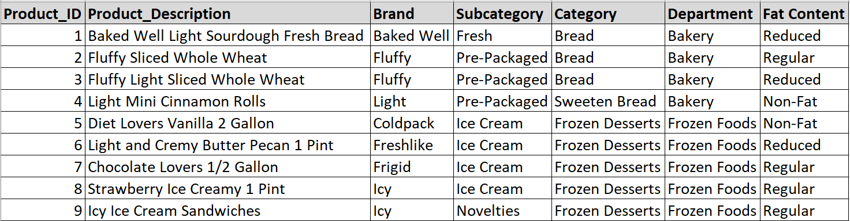
Multi-dimensional data in RDMS (Star Diagram Method)
Customer
(PK) Customer_ID
First_Name
…
Product
(PK) Product_ID
Prod_Desc
…
Measures
(FK) Customer_ID
(FK) Store_ID
(FK) Product_ID
(FK) Date_ID
Sales Quant
Sales Dollars
Store
(PK) Store_ID
Store_Num
…
Date
(PK) Date_ID
Date
…

Slide 42
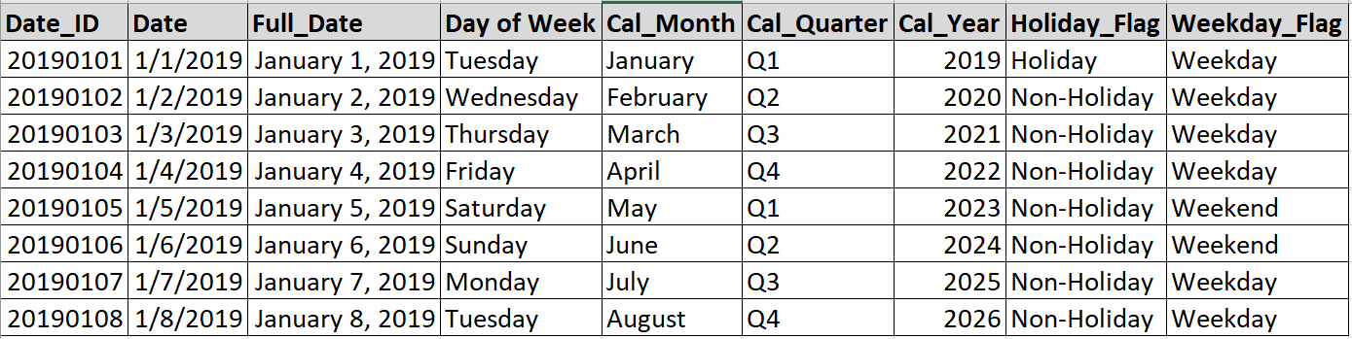
Multi-dimensional data in RDMS (Star Diagram Method)
Customer
(PK) Customer_ID
First_Name
…
Product
(PK) Product_ID
Prod_Desc
…
Measures
(FK) Customer_ID
(FK) Store_ID
(FK) Product_ID
(FK) Date_ID
Sales Quant
Sales Dollars
Store
(PK) Store_ID
Store_Num
…
Date
(PK) Date_ID
Date
…

Slide 43
Multi-dimensional data in RDMS (Star Diagram Method)
Customer
(PK) Customer_ID
First_Name
…
Product
(PK) Product_ID
Prod_Desc
…
Measures
(FK) Customer_ID
(FK) Store_ID
(FK) Product_ID
(FK) Date_ID
Sales Quant
Sales Dollars
Store
(PK) Store_ID
Store_Num
…
Date
(PK) Date_ID
Date
…

Slide 44
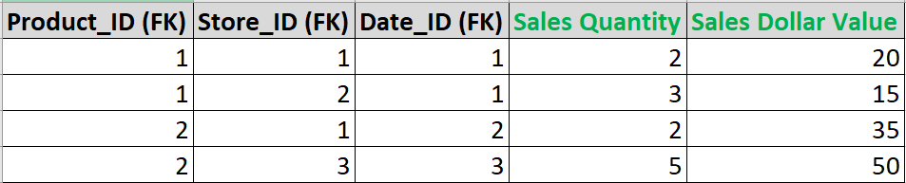
Multi-dimensional data in RDMS (Star Diagram Method)
Customer
(PK) Customer_ID
First_Name
…
Product
(PK) Product_ID
Prod_Desc
…
Measures
(FK) Customer_ID
(FK) Store_ID
(FK) Product_ID
(FK) Date_ID
Sales Quant
Sales Dollars
Store
(PK) Store_ID
Store_Num
…
Date
(PK) Date_ID
Date
…

Slide 45
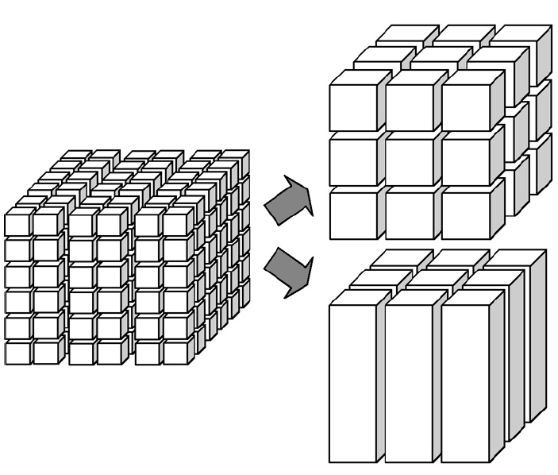
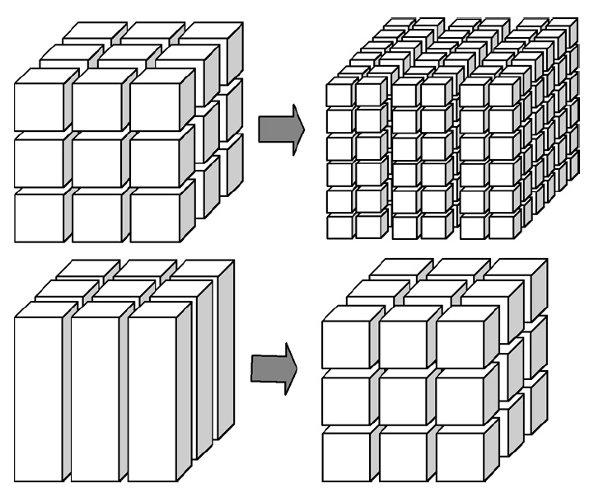
OLAP Operations
Roll up: Summarize data (e.g.Total sales by year/quarter by product category by region.)
Drill down, Roll down: Go from higher level summary to lower level detailed data (e.g. See detailed sales for a single product or city)

Slide 46
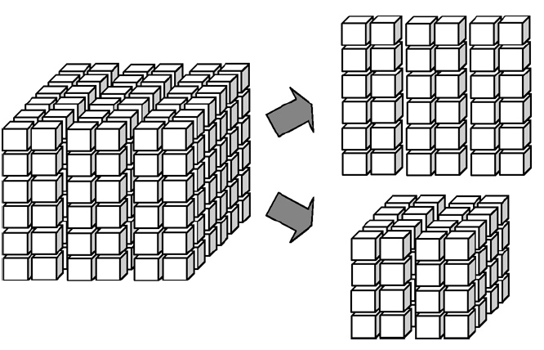
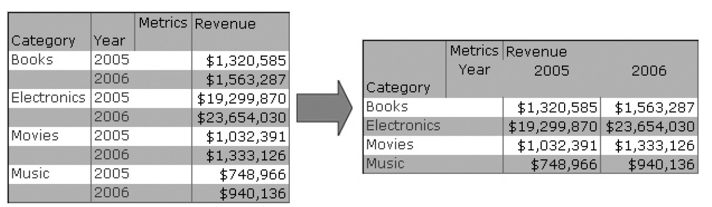
OLAP Operations
Slice and Dice: Select a whole dimension or combo of 2 e.g. Slice - Sales of a single product across all time and geographic dimensions e.g. Dice – Sales of single product, region, and time window
Pivot: rotate the cube to show a particular face (e.g Both show sales by Category/Year)

